Slide 1
Monthly Update on 2018-2019 WRAP Workplan June 24th, 2020 TSC and Work Group Co-Chairs Call
Regional Technical Operations WG
Regional Haze Planning WG
Control Measures Sc

Slide 2
Regional Technical Operations Work Group

Slide 3
Workplan Progress by RTOWG
Workplan Progress over the Last Month
Weekly co-chair coordination calls
Weekly calls with Ramboll to keep track of modeling progress
Modeling spec sheet updates to
Source apportionment modeling using the 2028 on-the-books emissions scenario (updated 5/18/20)
Weighted Emissions Potential (WEP) and Area of Influence (AOI) Analyses (updated 5/15/20)
Weighted Emissions Potential (WEP) and Area of Influence (AOI) Analyses for Alaska and Hawaii (updated 5/18/20)

Slide 4
Workplan Progress by RTOWG
Workplan Progress over the Last Month
RepBase high level source apportionment (international, natural, fires) and 2014v2 model performance results uploaded to TSS
WESTAR-WRAP Regional Haze Work Plan Completion & Results Virtual Remote Meeting #2, focused on modeling, 6/23 & 25

Slide 5
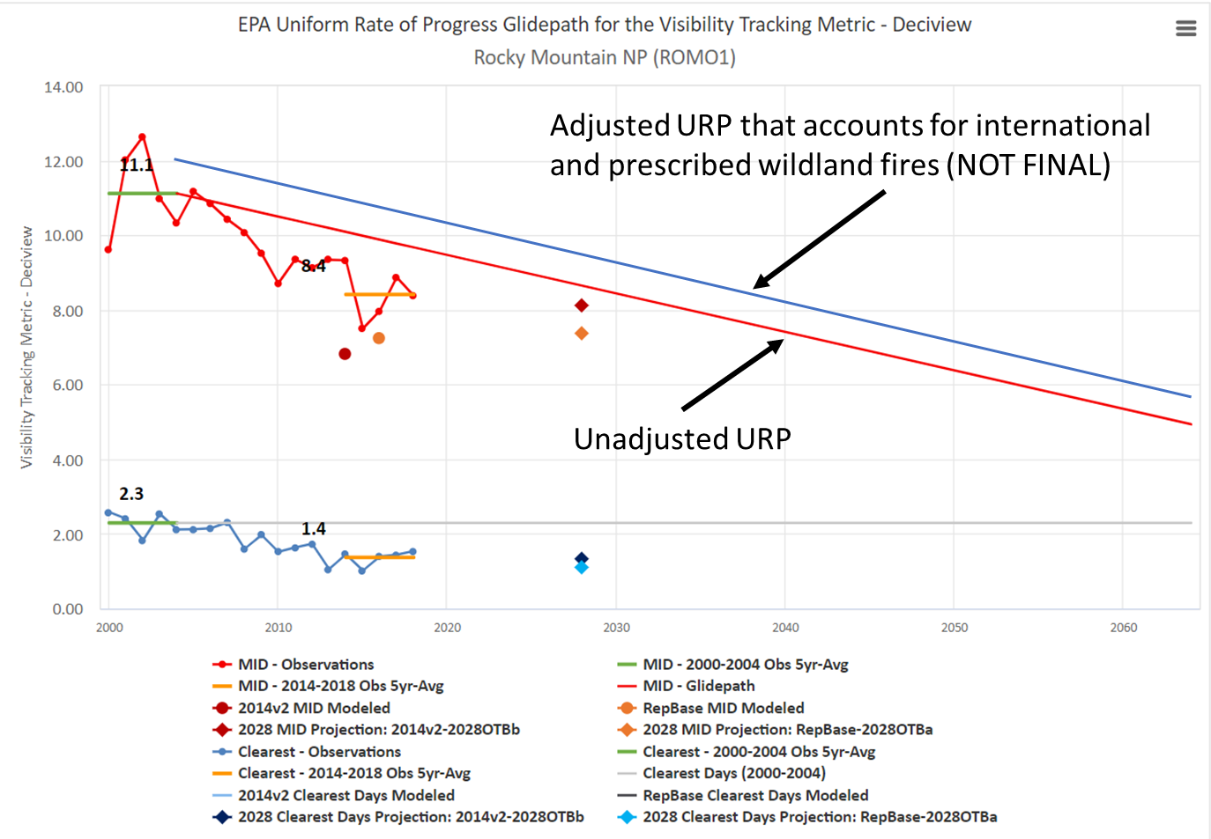
Example high-level source apportionment results to examine international, natural, and fire emissions at Rocky Mountain NP

Slide 6
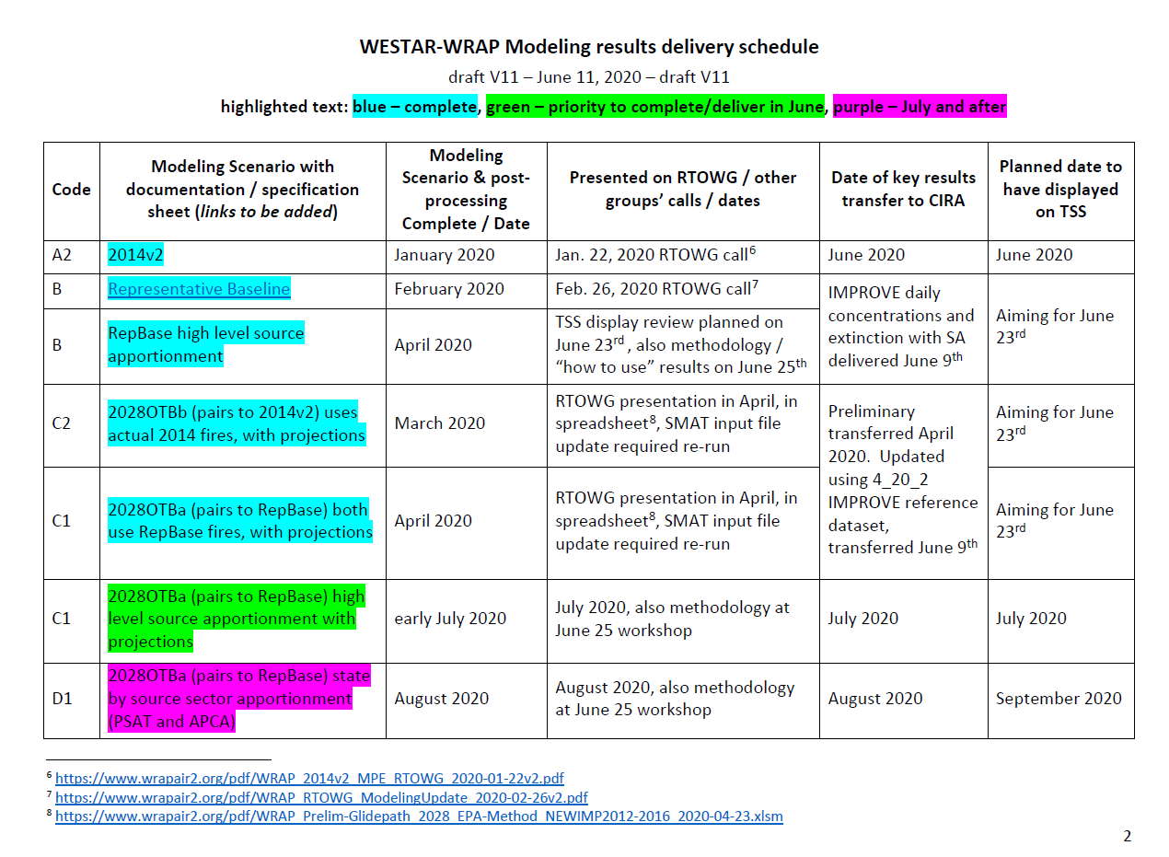
RTOWG modeling priorities

Slide 7
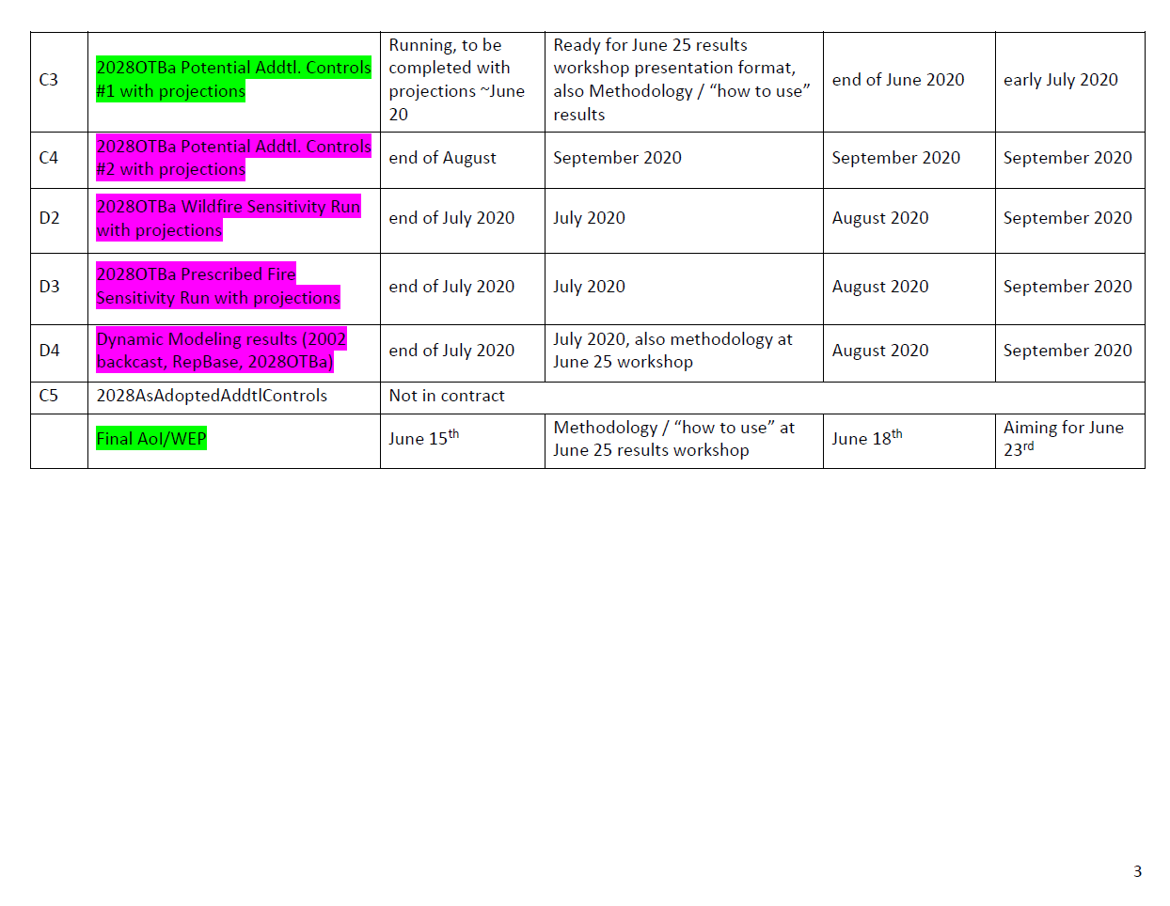
RTOWG modeling priorities

Slide 8
Workplan Coordination Activities by RTOWG
Workplan Coordination Occurring over the Last Month
Ramboll
Workplan Coordination Needed over the Next Two Months
Ramboll
Other workgroups as needed for investigating/discussing model results

Slide 9
Regional Haze Planning Work Group

Slide 10
Workplan Progress by Regional Haze Planning Work Group
Workplan Progress over the Last Month
Subcommittee Calls
June 23 & 25 Virtual Workplan Completion & Modeling Results meeting
Focused on Modeling Results on the TSSv2
Workplan Tasks for the Next Two Months
July 22 & 23 Virtual Workplan Completion & Modeling Results meeting
Focused on Modeling Results on the TSSv2
August 2020
August 2020
Notes:
1) RTOWG modeling - Ralph Morris (Slides to be posted to the RHPWG website after call) Update/progress presentation
Round 1 2028 Potential Additional Controls summary and next steps - David and Tom (Slides to be posted after call) Responses received from states and state summary of data/changes.
July 1, 2020 deadline for states to submit “refined” (or initial if not done 3/16) for additional modeling sensitivity run
4) Mobile Source Emissions Inventory Projections project. (David/Jay/Tom) Final memo and deliverables available on project wiki page: Mobile Source Emissions Inventory Projections Project
5) WRAP State Regional Haze Progress Website (Amber)

Slide 11
Workplan Progress by RH Planning Work Group – Control Measures Subcommittee
Workplan Progress over the Last Month – May Call
States provided updates on 4-factor review work
Most states have received the requested source information and are reviewing source control options, feasibility and costs
Many states are starting internal discussions on emission control costs and the appropriate cost effectiveness threshold
States discussed timing for submitting projected emission reductions for second model run – 2028 Potential Additional Controls (PAC)
Most states seem to support providing projected reductions around end of July or maybe early August, but depends on the release of first model run and needing some time to review model output
Workplan Tasks for the Next Two Months
Next call on June 22nd
States to continue 4-factor review work
States to review AOI and WEP analysis when it becomes available

Slide 12
Proposed Future Projects by RH Planning Work Group – Control Measures Subcommittee
Potential Additional Future Project/s
Depending on progress of emission control decisions, States considering whether an extra modeling analysis could be done over the summer or early fall
Coordination with the Emissions Inventory and Modeling Protocol Subcommittee is necessary to estimate potential emission reductions and timing of modeling

Slide 13
End of Workplan Progress Update

